Slide 1
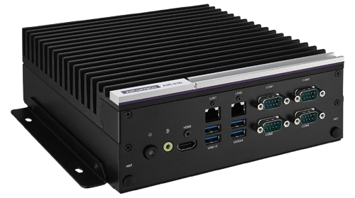
AI on the AIR-030
Elvis Los & Bodi Sadman

Slide 2
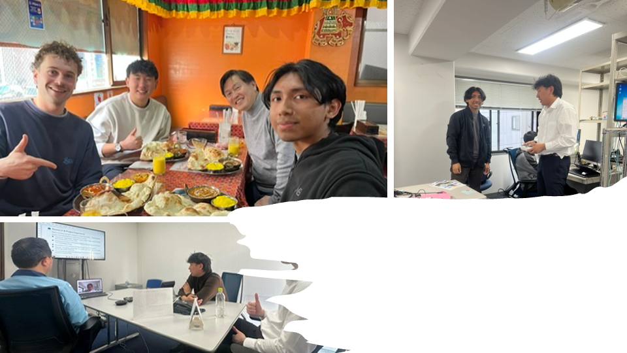
Advantech Intern Team
Elvis Los, Bodi Sadman, Andrew

Slide 3
RAG (Retrieval-Augmented Generation)
Retrieval-Augmented Generation (RAG) is an AI technique that combines information retrieval with text generation to improve the accuracy and relevance of responses. It works by:
Retrieving relevant documents from a knowledge base (e.g., a database, a vector store, or an external source) based on the user’s query.
Augmenting the input by providing the retrieved documents to a language model.
Generating a final response using both the retrieved data and the model's internal knowledge.
With RAG, you don’t train a model from scratch. Instead, you create a database (knowledge base) with your documents, and an existing LLM (like GPT) retrieves the relevant info from it in real-time.
For this we used an open source repository from NVIDIA called Jetson Copilot
Open this link and follow the installation and start procedure and support
https://www.jetson-ai-lab.com/tutorial_jetson-copilot.html

Slide 4
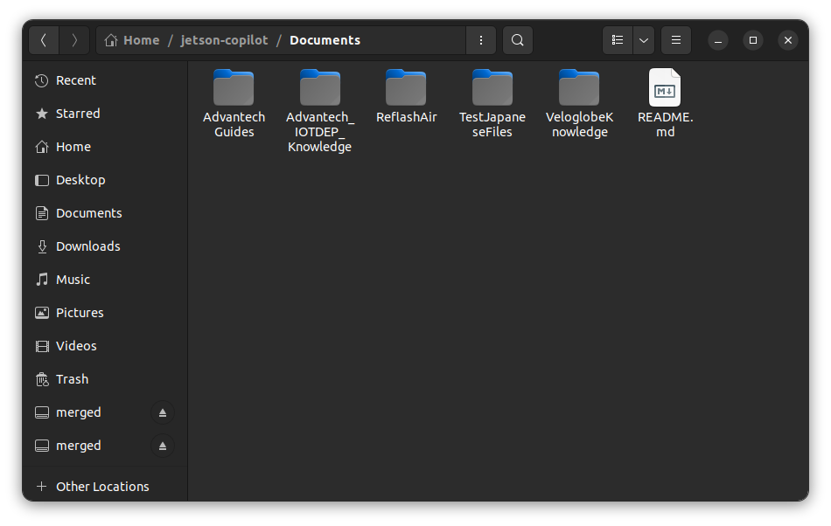
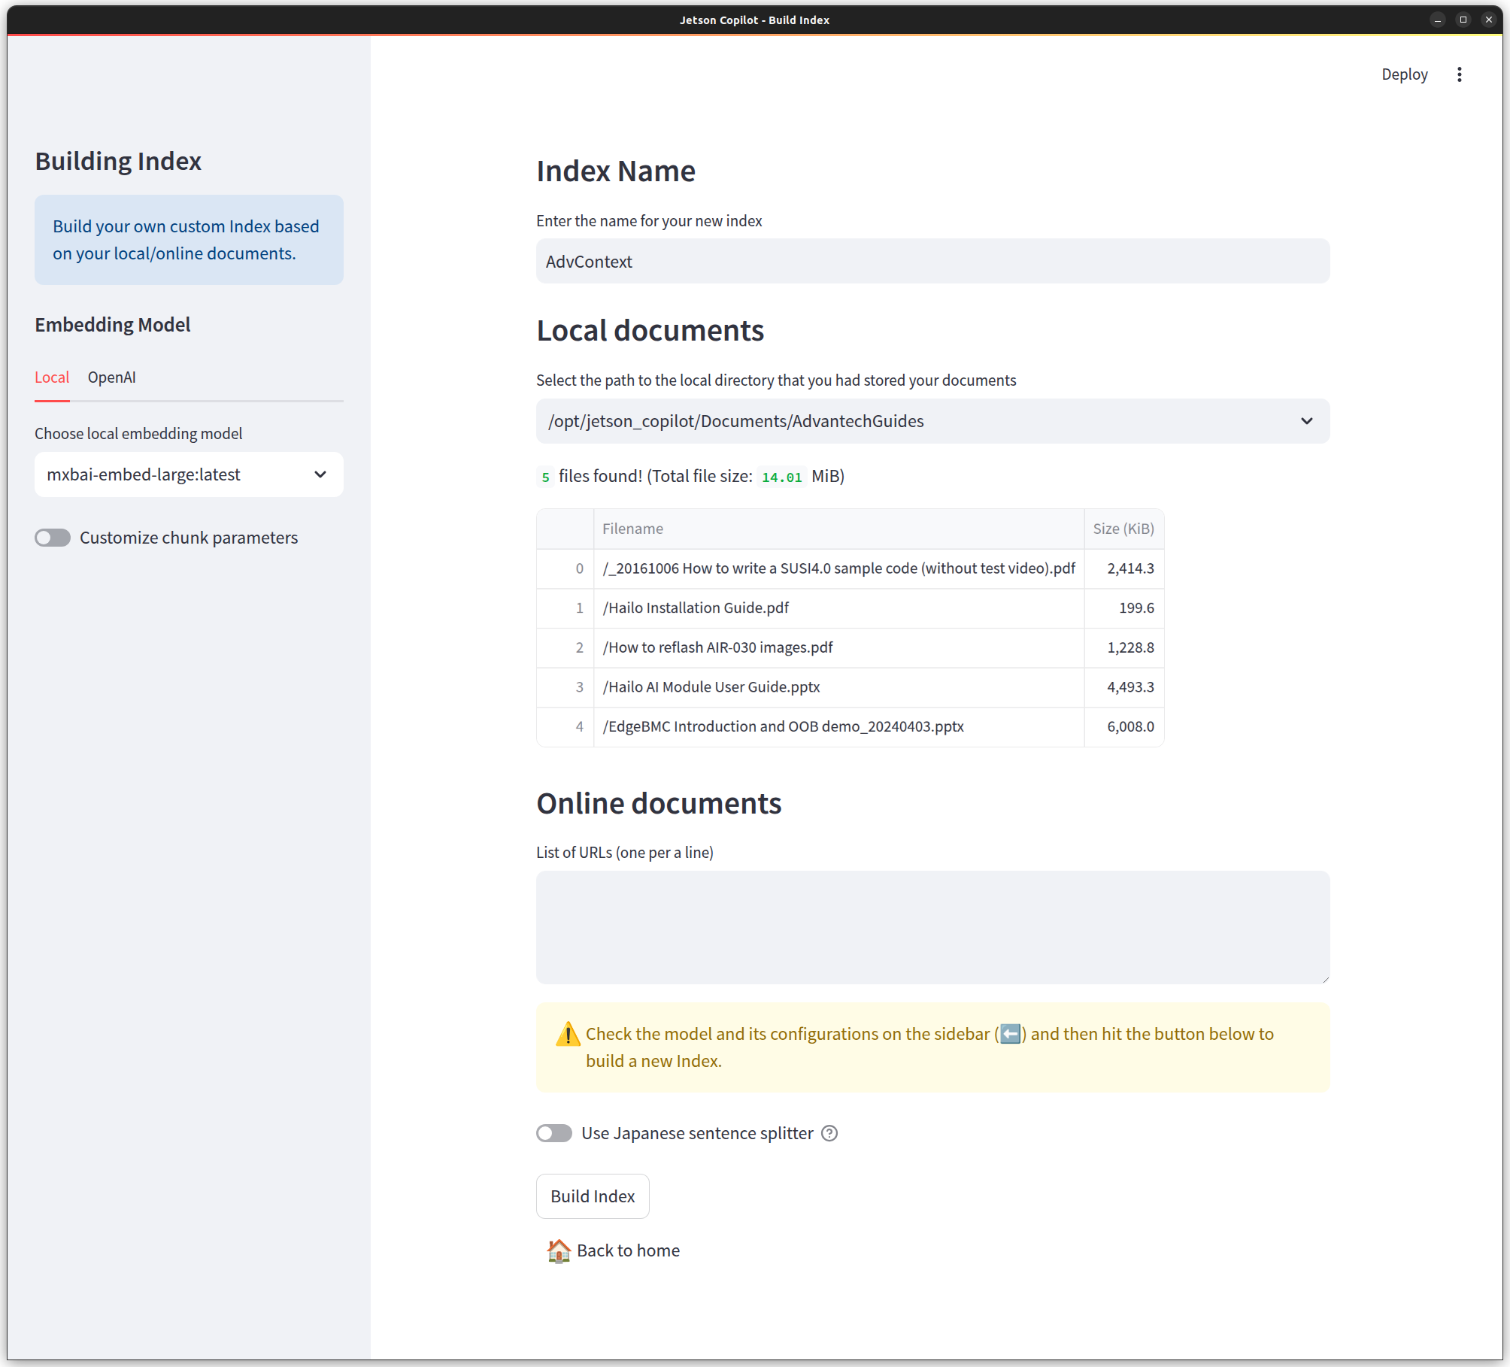
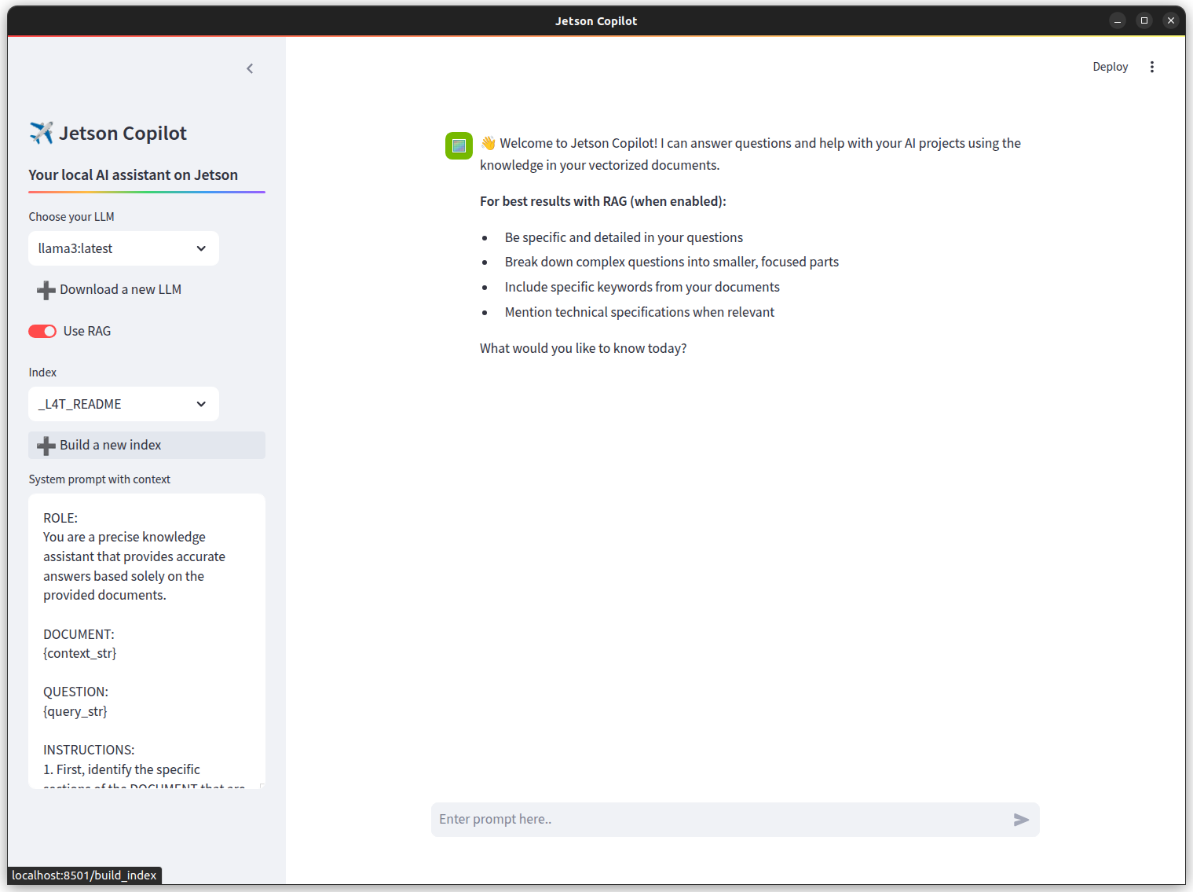
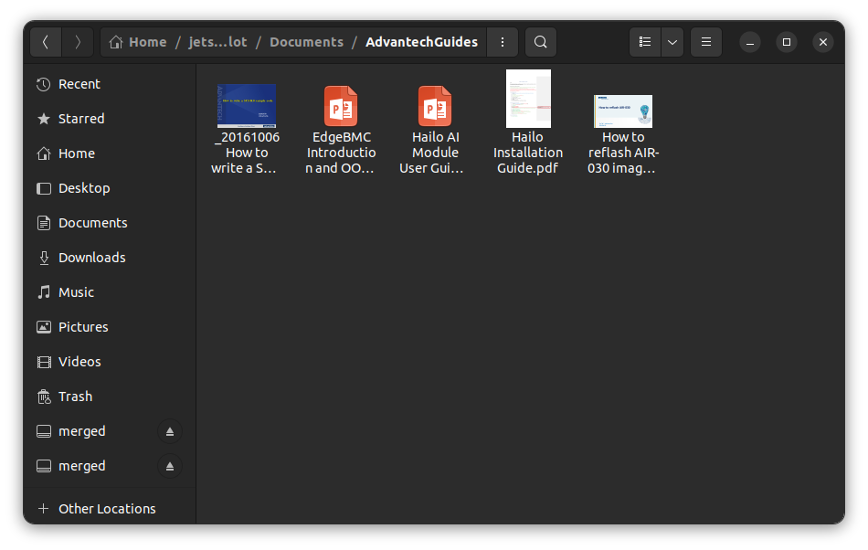
Building an Index & Selecting Index for RAG
1
Create a knowledge base creating a new folder inside jetson-copilot/Document
3
2
4
Start Jetson Copilot, Enable Rag and build a new index
Select your knowledge directory and build the new Index. Jetson Copilot will handle creating and managing the vector database behind the scenes
Add your files to your created folder
Supported files: 'txt', 'csv', 'docx', 'epub', 'hwp', 'ipynb', 'jpeg', 'jpg', 'mbox', 'md', 'mp3', 'mp4', 'pdf', 'png', 'ppt', 'pptm', 'pptx', 'xlsx', 'xls'

Slide 5
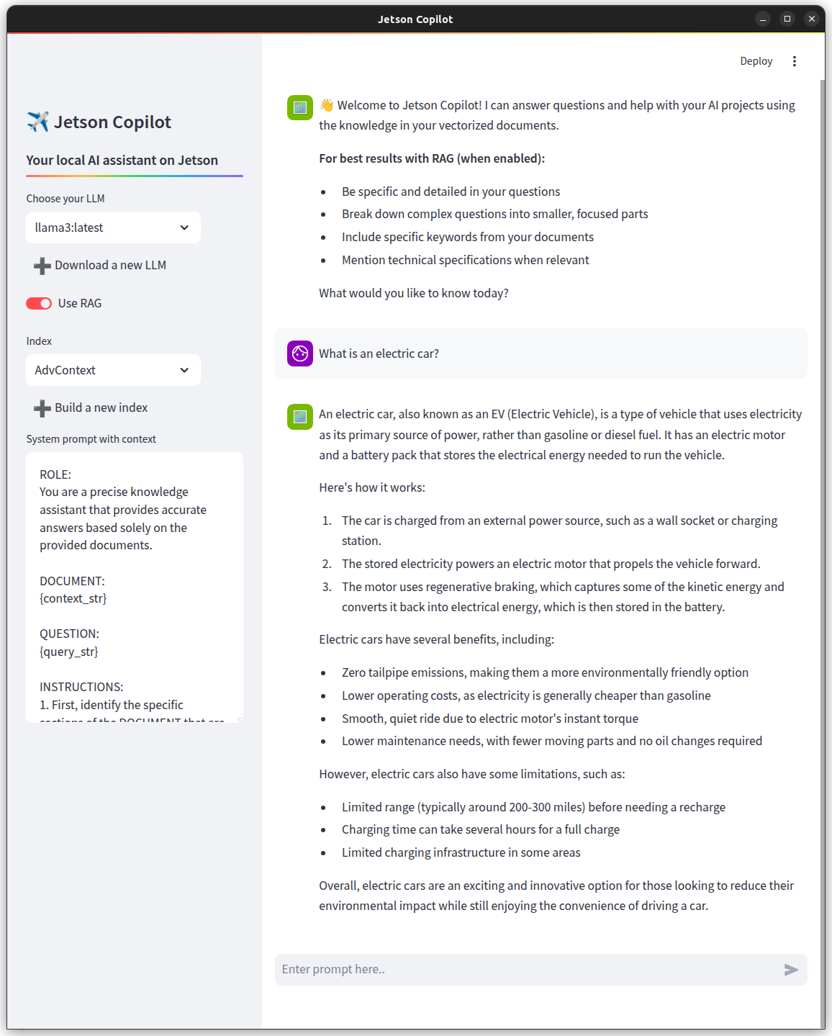
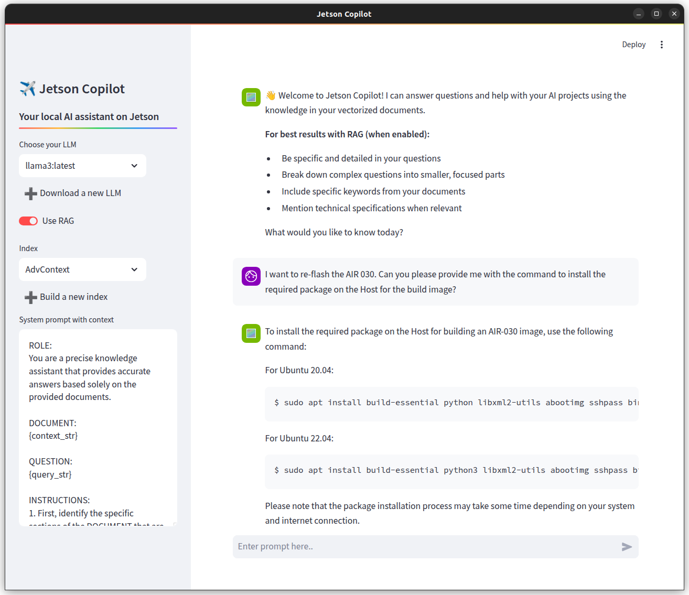
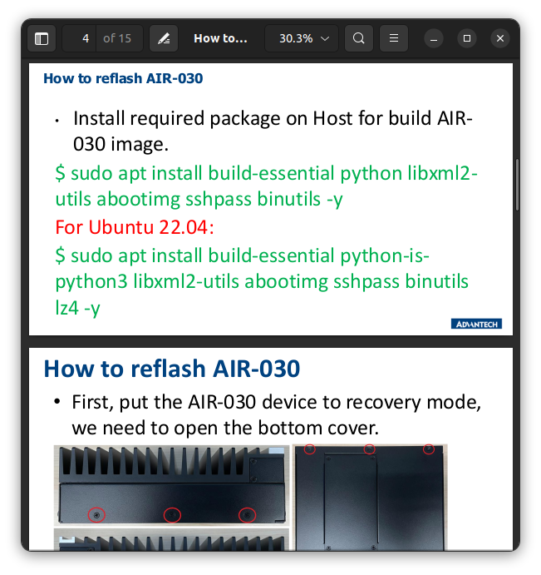
Testing RAG
Just like a regular LLM, RAG can answer general questions it was trained on, but it also uses a retrieval component to find relevant information from your documents for more accurate, up-to-date answers.
As you can see, RAG was able to retrieve and generate the correct response

Slide 6
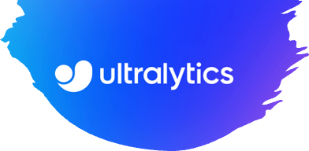
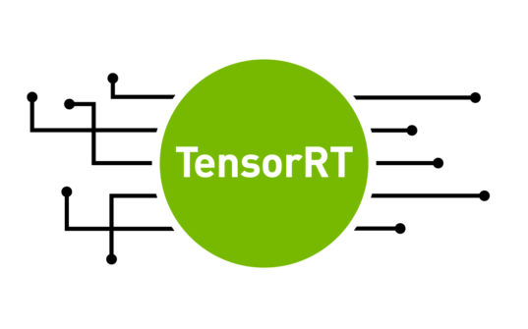
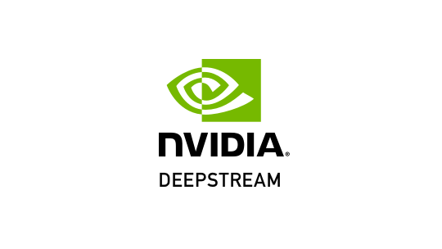
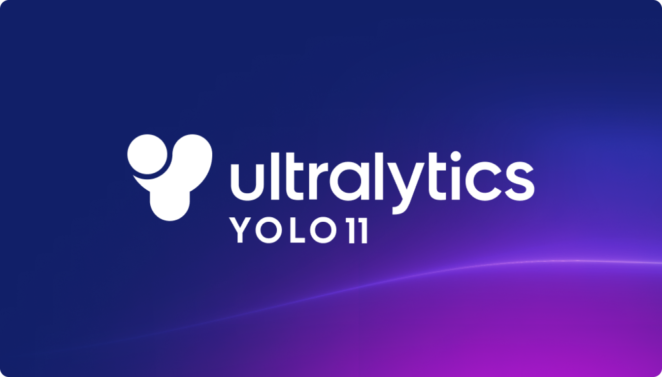
Introduction to AI
These are the topics we’re going to discuss:
YOLO (You Only Look Once)
COCO
PyTorch
TensorRT
Onnx files
Engine files
Ultralytics
Deepstream

Slide 7
YOLOv11 – "You Only Look Once"
YOLO is a popular object detection and image segmentation model, was developed by Joseph Redmon and Ali Farhadi at the University of Washington. Launched in 2015, YOLO quickly gained popularity for its high speed and accuracy.
The model we’re using in this SOP:
YOLO11: Ultralytics' latest YOLO models delivering state-of-the-art (SOTA) performance across multiple tasks, including object detection, segmentation, pose estimation, tracking, and classification, leverage capabilities across diverse AI applications and domains.

Slide 8
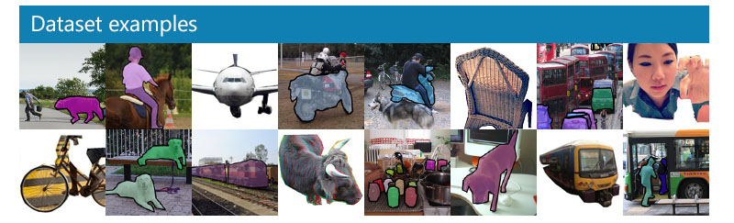

COCO & PyTorch
COCO (Common Objects in Context)
dataset is a large dataset for object detection, segmentation, and captioning. COCO has 330K images (>200K labeled) and 80 object categories.
PyTorch
is a tool that helps you build and train AI models — especially deep learning models like those used in computer vision and natural language processing.

Slide 9
TensorRT – "The AI Booster"
What it is: A tool from NVIDIA that makes AI models run faster on NVIDIA GPUs. Up to 5x faster inference via hardware optimization.
What it’s used for:
Making AI tasks like object detection, translation, or classification run faster and with lower latency.
Especially useful when you want to run AI models in real-time (e.g., on a live video stream or camera).
You can apply precision calibration (e.g. from FP32 to FP16 or INT8)

Slide 10
ONNX vs Engine files
What is an ONNX file?
Before TensorRT can optimize a model, the model must be converted into a universal format called ONNX (Open Neural Network Exchange.)
It’s a standard file format that allows you to move models between frameworks, like PyTorch → TensorRT.
Think of it as a "bridge file" that allows TensorRT to understand the model and prepare it for acceleration.
What is an Engine File?
Once TensorRT has read the ONNX file and applied all its optimizations it compiles the model into an engine file.
An engine file is the final, fully optimized binary ready to run on NVIDIA hardware.
It runs extremely fast — but it’s tied to the GPU and can’t easily be changed or retrained.

Slide 11
Ultralytics – "The Easy YOLO Toolkit"
What it is: A company (and open-source project) that makes it super easy to use YOLO, especially for beginners.
What it’s used for: Creating your own object detection system with almost no code — very popular in research and small businesses.
Ultralytics is built on PyTorch — but hides the complexity so you don’t have to deal with code unless you want to.

Slide 12
DeepStream
What it is: A platform by NVIDIA to handle video + AI together, especially on live streams. It creates GPU-accelerated pipelines for NVIDIA edge devices.
What it’s used for: Smart cities, traffic monitoring, retail surveillance, and factory automation.

Slide 13
Let the DEMO begin

Slide 14
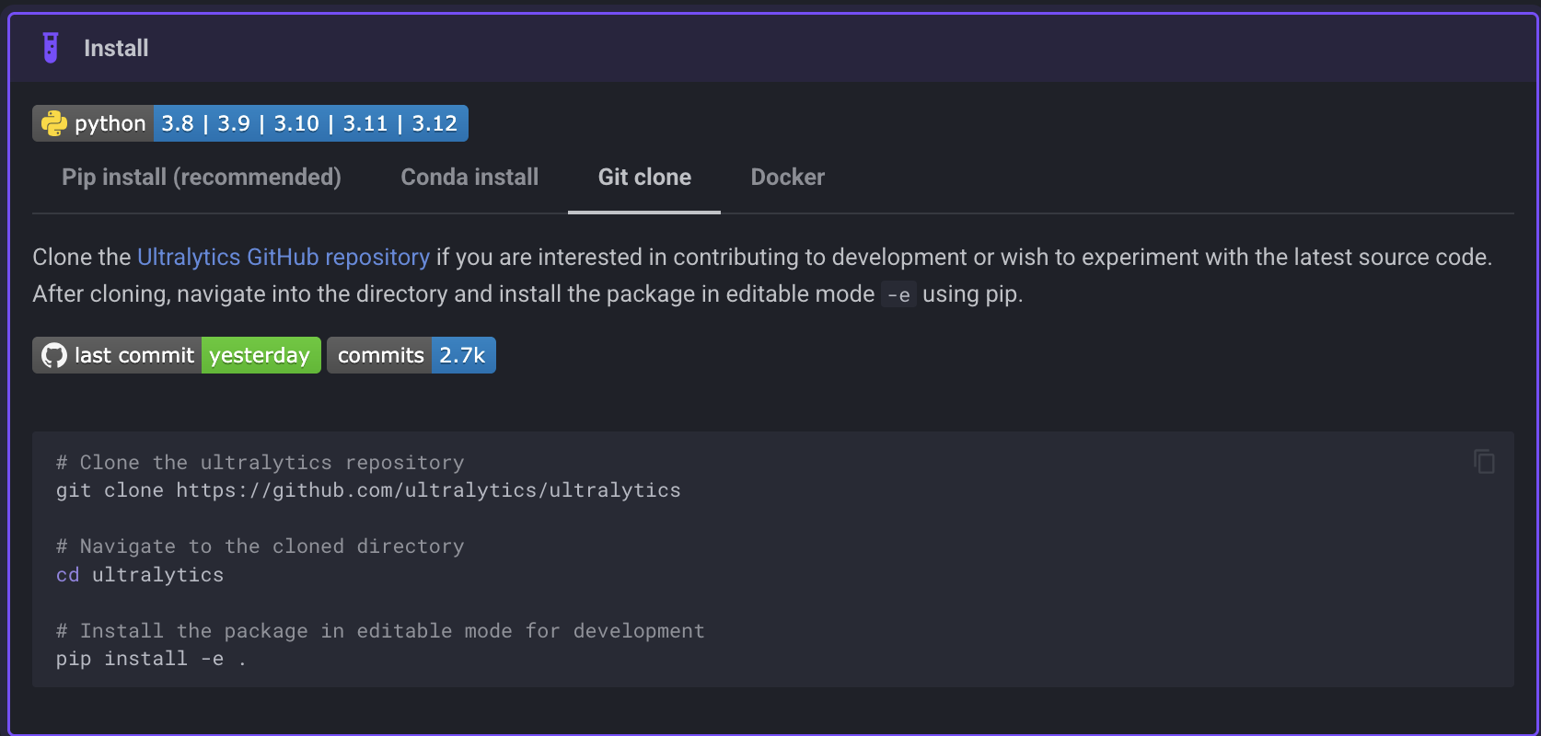
Installing Ultralytics
https://docs.ultralytics.com/quickstart/

